Slide 1


Training – Agile and Agile Testing

Slide 2

First things First!
What do we mean by Agility?

Slide 3
Agility is response to change
Things change
  Requirements change
  Needs change
  Priorities change
  Technology changes
The question really becomes how should we deal with change

Slide 4
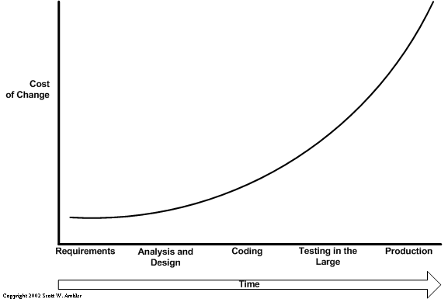
Cost of Change
Traditional Vision:
the cost of change grows exponencially with time

Slide 5
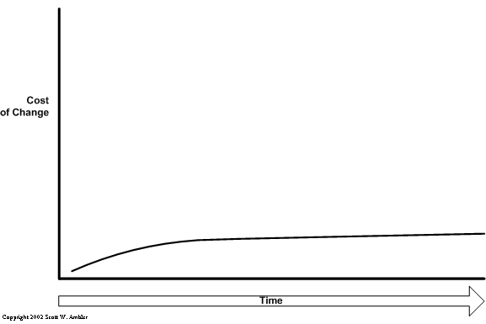
Costo of Change (Cont.)
New Paradigm: “flatten the curve”
  Solve Problems all the time

Slide 6
Agile is not …
Just a collection of practices
A silver bullet
A check list of things to do on every project
  While there are common practices and principles
  It does need to be applied and tailored

Slide 7
Agile is …
A set of Values accepted by the organization and used to guide teams to reach their collective and individual objectives
A group of Principles by which discrete practices can be crafted

Slide 8
Agile Values
Individuals and interactions over processes and tools
Working software over comprehensive documentation
Customer collaboration over contract negotiation
Responding to change over following a plan
www.agilemanifesto.org
Notes:
“We are uncovering better ways of developing software by doing it and helping others do it.
Through this work we have come to value: “
That is, while there is value in the items on
the right, we value the items on the left more
The only concern with the term agile came from Martin Fowler (a Brit for those who don’t know him) who allowed that most Americans didn’t know how to pronounce the word agile.

Slide 9
Basic Concepts
Release
Iteration/Sprint
Backlog
  Product Backlog
  Release Backlog - Baseline
  Iteration Backlog - Baseline
Product Backlog Item
Story/Card
Task
Notes:
Basic Concepts:
Iteration/Sprint:
-- Sprints are 2 or 4 weeks
Product Backlog
All work items for the whole product
Release Backlog
-- All work items for a release
-- Prioritized by customer
Sprint Backlog
-- Contains work items for the sprint timebox
Story
Name of a sprint work item
Brief specification of a customer facing solution
Is a token for a conversation
Between team members and with Product Specialist
Problem decomposition in action, many stories = big problem
A good story
Has business value
Is Understandable
Is estimable
Is testable
A story is ready for development when it meets the above criteria and has an estimate and acceptance criteria

Slide 10
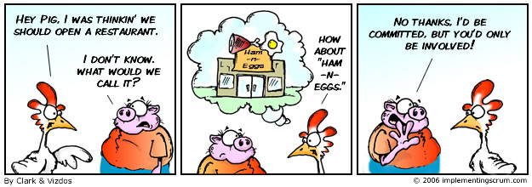
Roles - Pigs and Chickens
Notes:
Ken Schwaber started the pigs and chickens story in the early days of Scrum.
The real issue for a Scrum is who is committed to the project and accountable for deliverables. The committed get to talk at the daily Scrum meeting. They are the pigs and their butts are on the line. We could call them contributors if we don't like pig terminology.
People who are not committed to the project and are not accountable for deliverables at the meeting do not get to talk. They are excess overhead for the meeting. They might be called eavesdroppers if you don't like chickens. Whatever we call them it should have a negative connotation because they tend to sap productivity. They are really suckers or parasites that live off the work of others.
Most of excess overhead will claim they need to know what is going on because it impacts their work in some way. They don't need to know what is going on in the Scrum. They need to be able to see a visual representation off the backlog that is updated daily, preferably automatically on the web. At the end of the Sprint, they get to go to a demo where they can see exactly what went on, can provide their input, and can influence the next Sprint. This is where they can provide a real contribution.
One of the biggest challenges Ken and I had in various companies where we worked together was stopping members of Scrum from going to any excess overhead corporate meetings because they were one of the biggest suckers of productivity from the team. People that like to go to these meetings are often seen in a Scrum whining about not completing their deliverables because they were at such meetings.

Slide 11










Roles
Product Owner
Coach
Defines product vision and features
Decides on release date and content
Prioritizes features according to business value
Adjusts features and priority every iteration, as needed
Accepts or reject work results
Responsible for enforcing Agile values and practices
Removes impediments
Ensures that the team is fully functional and productive
Enables close cooperation across all roles and functions
Shields the team from external interferences
The team
Typically 5 to 10 people
Self-organizing and cross-functional
Estimates product backlog, breaks-down stories in estimated tasks and commits with the iteration scope
Performs all the tasks required to deliver value to the customer through small product increments

Slide 12
Planning & Monitoring
-
+
Release
Detail
Iteration
Stand-up

Slide 13






Planning
Release Planning
  Focuses on the next Release
  ONLY!
Iteration Planning
  Focuses on the next Iteration
  ONLY!

Slide 14
Release Planning
Relative estimates
Choose an abstract unit of measure
  Points, Rocks, Gummi Bears…
Stories are estimated only in relation to other stories
  This story is more complex than that one.
  This story is more tedious than the other one.
  These stories are equally challenging and time consuming
Planning Poker Technique
  A technique to estimate user stories with an acceptable relation between effort invested and accuracy obtained.
  The scale proposed is based on the Fibonacci: sequence: 0; 1, 2; 3; 5; 8; 13
  Each number represents a bucket where stories with approximately similar size will be placed.
Notes:
The size does not represent time duration required to deliver a story, rather it rolls up a set of attributes like effort required, complexity, technical risk, business uncertainty and so on. Story points are relative: a user story with 2 story points is approximately twice a 1 point user story.

Slide 15
Self correcting estimates
If you estimate only once at the beginning of a project, you only get one chance to be right.
Estimating every iteration, gives you an increasingly greater chance of being right every two weeks
Notes:
We all experienced the task slipping Project’s gantt chart

Slide 16
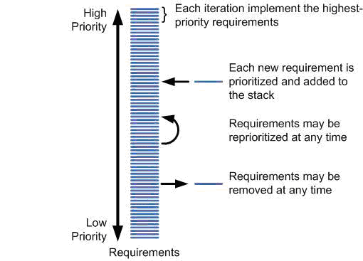
During a release …

Slide 17
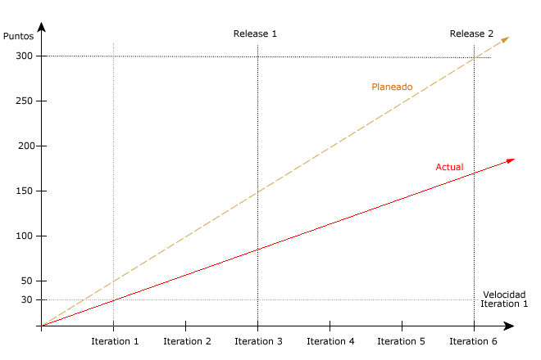
Monitoring - Release Burn Up Chart
At the end of each iteration the Release Plan is revised.

Slide 18
Iteration Estimation
The purpose of iteration estimation is to produce fine-grained estimates which will be used to create a low level plan for a short period of time.
Unless the project team is made up of more than 6 TM, the entire team should estimate the stories together.
At this stage we estimate effort, breaking down stories into tasks.
Notes:
If a team is greater than 6 developers, the stories should be broken into multiple backlogs and the team divided into sub-teams so that no sub-team is greater than 6. The sub-teams do not have to be permanent (across the project duration) but should last for at least 1 iteration.

Slide 19
Tasks
Tasks are components of Stories
  Not necessarily measurable in terms of Business Value
  Atomic
  Can be done in a couple of days
    Must be completed in less than a week
      Absolutely, without question
        Otherwise, you are working on more than one task
        and don’t realize it
  Do not show up on Burn up chart
    Story status is defined by all or nothing

Slide 20

During the Iteration…
External changes
during a sprint
are not allowed
Adding and/or taking out US
Internal changes
Iteration Baseline
Change Control Meeting
New Iteration Baseline
Consider cancelling the iteration if business needs change.
US additions or removals should be agreed with Product Owner.

Slide 21
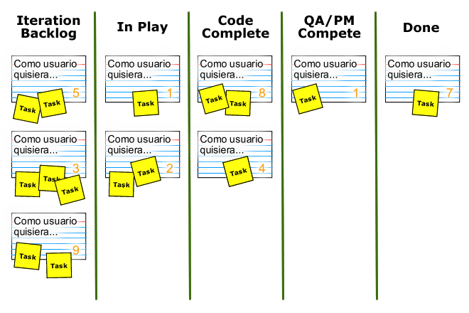
Taskboard
QC
Complete

Slide 22
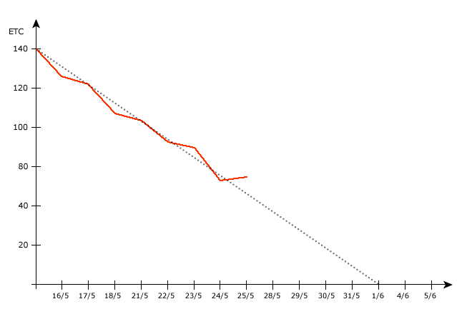
Iteration Burn Down Chart
Daily monitoring of remaining effort to complete tasks.

Slide 23

Iteration Cycle
Daily Stand Up
Meeting
Development
Iteration
24 Hours
Release
Backlog
Iteration
Backlog
Potentially
Shippable
Product
Increment
2-4 Weeks
Diagram adapted from an image available at http://www.mountaingoatsoftware.com
Original diagram: Copyright @ 2005, Mountain Goat Software
Iteration
Planning
Meeting
Iteration
Review
Retrospective
Meeting

Slide 24
Scrum/Stand up
Stand up meetings to keep everyone informed.
Limit it to three answers:
  What did I achieve yesterday?
  What am I planning to do today?
  What’s in my way?
Don’t go into details. Schedule other meeting if necessary.
Notes:
This doesn’t mean meetings all the time
Thirty minutes to an hour after the arrival time is a good moment for stand ups. Let people leave their cout, have some coffee and check mail.
Rules: only team members can speak “pigs”.

Slide 25
Benefits of Stand ups
Kick off the day ahead in a focused way
Bring issues out
Help determine areas that need additional help
Identify redundancy or areas where someone else has a solution
Seeing others report progress motivates each of us to do the same
Notes:
Manger can realizae they need more resources, or more senior developers.
Stand ups kee the team on the same page. Keep the meeting short, focused and intense.
Don’t skip it anyone is missing.
Avoid reporting to the PM. You don’t have to justify your salary in these meetings, we all assume you are working!

Slide 26
Demo: Get frequent feedback
Use Demos to get feedback from customer.
Once they begin to use portions of the system and realice its impact and possibilities, ideas and expectations evolve naturally.
Success is based on how close you end up to your customer’s expextations.
Be proactive.
Set the expectations: let them know they are looking at an application under development.
Track Issues.
Notes:
You can’t freeze requirements any more than you can freeze markets, competition, learning, evolution or growth.
BE PROACTIVE: don’t think that the customer let a prize uncollected “You miss it” attitude. You are missing a great chance to valdiat business value added.
As the project progresses, you’ll get lot of feedback. Track issues.
Some clients may feel that biweekly demos are too much for them to handle. Be respectful of their time.
If you do demos very often, you may have no time to write code and have something to show.

Slide 27
Retrospective
  Done after every Iteration
  Driven by the Team
  Attended by the Team
    Except in specific situations
  Key is to identify actionable changes
    And make the changes
What worked well
What did not
Things to try
Areas to work on

Slide 28
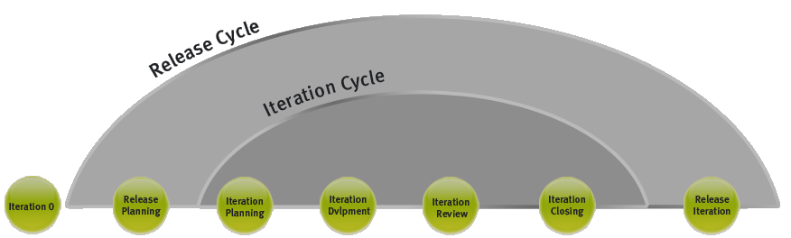
Project Cycle

Slide 29
Agile Testing
Notes:
Read the followings chapters (1, 2,5, 6, 7, 8, 9 ,10,13,14 and 15) of a book called “Agile Testing - A Practical Guide for Testers and Agile Teams”, by Lisa Crispin and and Janet Gregory. We really consider that this book provides a wonderful knowledge background and will really help all of you to understand and be productive regarding agile testing strategy.

Slide 30
Traditional Testing
Phased/Gated projects
Done after coding finishes
Works after requirements are specified
Not involved up front
Silos organization
Little personal interaction with the team
Bussiness Analyst
Developers
Testers

Slide 31
Agile Testing
Testers are part of the development team
Participate in plannings and estimations
Collaborate to identify acceptance tests
Starts at the same time as everyone else
Testers work along developers
Whole team is responsible for quality
Bussiness Analyst
Developers
Testers
Notes:
We define an agile tester this way: a professional tester who embraces change, collaborates well with both technical and business people, and understands the concept of using tests to document requirements and drive development. Agile testers tend to have good technical skills, know how to collaborate with others to automate tests, and are also experienced exploratory testers.

Slide 32
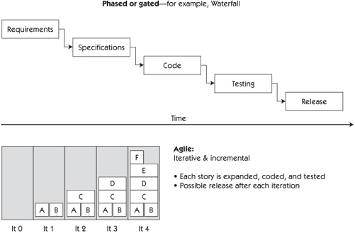
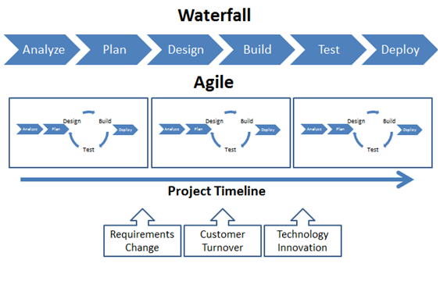
Agile vs. Staged
In the phased approach diagram, it is clear that testing happens at the end, right before release.
As in agile timeframes are greatly shortened, activities happen concurrently. Participants, tests and tools need to be adaptive.We don’t think of departments, we just think of the skills and resources we need to deliver the best possible product.
Notes:
In the phased approach the diagram is idealistic, because it gives the impression there is as much time for testing as there is for coding. In many projects, this is not the case. The testing gets "squished" because coding takes longer than expected, and because teams get into a code-and-fix cycle at the end.
Agile is iterative and incremental. This means that the testers test each increment of coding as soon as it is finished. An iteration might be as short as one week, or as long as a month. The team builds and tests a little bit of code, making sure it works correctly, and then moves on to next piece that needs to be built. Programmers never get ahead of the testers, because a story is not "done" until it has been tested

Slide 33

Quality is first priority
Quality is baked in.
Agile teams work in short iterations in part to ensure that the app remains at a known state of quality.
A story is not done until it has been tested.
Quality
Notes:
It's helpful if some members of the technical team can participate in story-writing sessions so that they can have input into the functionality stories and help ensure that technical stories are included as part of the backlog. Programmers and testers can also help customers break stories down to appropriate sizes, suggest alternatives that might be more practical to implement, and discuss dependencies between stories.

Slide 34
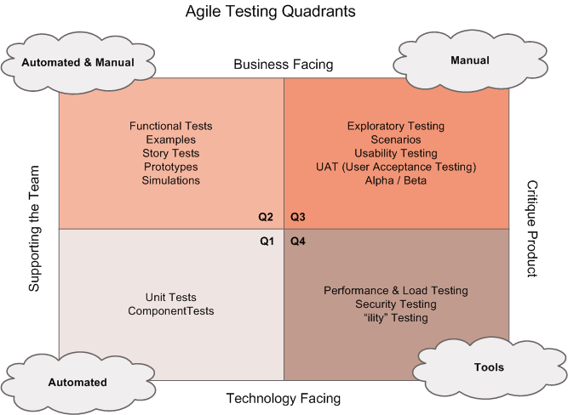
When we are done….
Notes:
The agile testing quadrants shows how each of the four quadrants reflects the different reasons we test. On one axis, we divide the matrix into tests that support the team and tests that critique the product. The other axis divides them into business-facing and technology-facing tests. The order in which we've numbered these quadrants has no relationship to when the different types of testing are done.
Use the quadrants to know when you're done, and ensure the whole team shares responsibility for covering the four quadrants of the matrix.

Slide 35
Skills
Change the approach:
From being part of adversarial teams (Dev vs. QA) to a whole-team ownership of quality
From building test scripts according to a requirements document to ask the questions as the stories are identified and coded.
If needed, everyone helps with testing tasks.
Notes:
The principles we think are important for an agile tester are:
Provide continuous feedback.
Deliver value to the customer.
Enable face-to-face communication.
Have courage.
Keep it simple.
Practice continuous improvement.
Respond to change.
Self-organize.
Focus on people.
Enjoy.

Slide 36
Skills (Cont.)
More about attitute than specific skills
Quit the “quality police” attitude
Jump into discussions with suggestions and questions
Pair with Product Owner and programmers

Slide 37
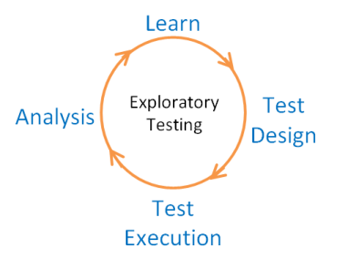
Exploratory Testing
An important approach to testing in the agile world combines simultaneous test design, test execution and learning.
It reveals areas of the product that could use more automated tests and brings up ideas of new or modified features.
Notes:
During exploratory testing sessions, the tester simultaneously designs and performs tests, using critical thinking to analyze the results. This offers a much better opportunity to learn about the application than scripted tests. It is guided by a strategy and operates within defined constraints. From the start of each project and story, testers start thinking of scenarios they want to try. . As a result, it is through this type of testing that many of the most serious bugs are usually found.
We can combine exploratory testing with test automation as well. Use automation to do test set up, data generation, repetitive tasks, or to progress along a workflow to the place you want to start. Then you start using your testing skills and experience to find the really "good" bugs, the insidious ones that otherwise escape attention. You can also use an automated test suite to explore. Just modify it a bit, watch the results as it runs, modify it again, and watch what happens.

Slide 38
Good Exploratory Tester
Attributes of a good exploratory tester
Is systematic but pursues “smells”
Learns to recognize problems through the use of Oracles
Chooses a theme or role or mission statement to focus testing
Time-boxes sessions
Thinks about what the expert or novice user would do
Explores together with domain experts
Checks out similar or competitive applications
Notes:
Smells: anomalies, pieces that aren´t consistent
Oracle: principle or mechanism by which we recognize a problem

Slide 39
Automation
A core agile practice
Good enough automation frees the team to deliver high-quality code frequently
Tests will tell right away wether or not the new code breaks anything.
Teams just go faster
Enables that regressions tests get run every iteration
Notes:
If we're thinking constantly about how to automate tests for a fix or new feature, we're more likely to think of testability and a quality design rather than a quick hack that might prove fragile. That means better code and better tests.
Teams just go faster than the ones relying exclisuvely on manual testing.
If regression tests are not automated, they won’t get run every iteration. The problem arises at the end of the release cycle.
Bugs that would have been caught early are found late.

Slide 40
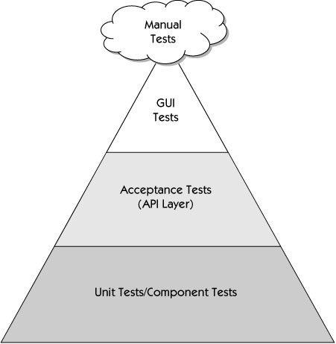
An Agile Approach to Test Automation
The agile test automation pyramid shows three different layers of automated tests:
The tests in this layer provide the lowest ROI. These tests are the ones done through the GUI, the ones that actually operate and manipulate the presentation layer
The tests in this layer may include "story" tests, "acceptance" tests, and tests that cover larger sets of functionality than the unit test layer. These tests operate at the API level or "behind the GUI," testing the functionality directly without going through the GUI.
This layer represents the bulk of the automated tests. They're generally written in the same language as the system under test, using the xUnit family of tools.

Slide 41
Recommendations
Start with those pieces of code that cause the greatest fear to change
Also features that take too long to be tested manually
GUI tests usually have the lowest ROI because they’re expensive to maintain
Notes:
Continuous integration running a robust suite of unit tests is a first step toward automating other tests.
With good coverage in your unit test and code integration tests you don’t need to automate as many functional tests

Slide 42
Apply coding practices
Tests are just as valuable as production code
Keep tests in the same source code control tool as your production code
Tag them along with code to identify versions
Undertake automation tasks with discipline

Slide 43
What not to automate?
Budgetary and/or technical restrictions
Unimportant tests increase build time unnecessarily
Automate just enough
Notes:
Not everything can be automated, because of budgetary or technical reasons.
Be aware of the increase of time to run the test suite for every build.
If it takes too long create a smoke test suite to run as part of your continuous integration build process and set up a separate machine to run the whole suite in parallell once the smoke tests pass.

Slide 44
Recommendation
Read the followings chapters (1, 2,5, 6, 7, 8, 9 ,10,13,14 and 15) of a book called “Agile Testing - A Practical Guide for Testers and Agile Teams”, by Lisa Crispin and Janet Gregory.
We really consider that this book provides a wonderful knowledge background and will really help all of you to understand and be productive regarding agile testing strategy.

Slide 45
Q&A
?

